Slide 1


PhD in Mathematical Models for Engineering, Electromagnetics and Nanosciences XL Cycle
Roberto Colarelli 1794473
Bachelor's degree:
Electronic Engineering
Master’s degree:
Nanotechnology Engineering
All rights relating to this educational material and its content are reserved to Sapienza and its authors (or teachers who produced it). Personal use of the same by the student for study purposes is permitted. Any dissemination, duplication, transfer, transmission, or distribution to third parties or the public is absolutely prohibited under penalty of applicable law.

Slide 2
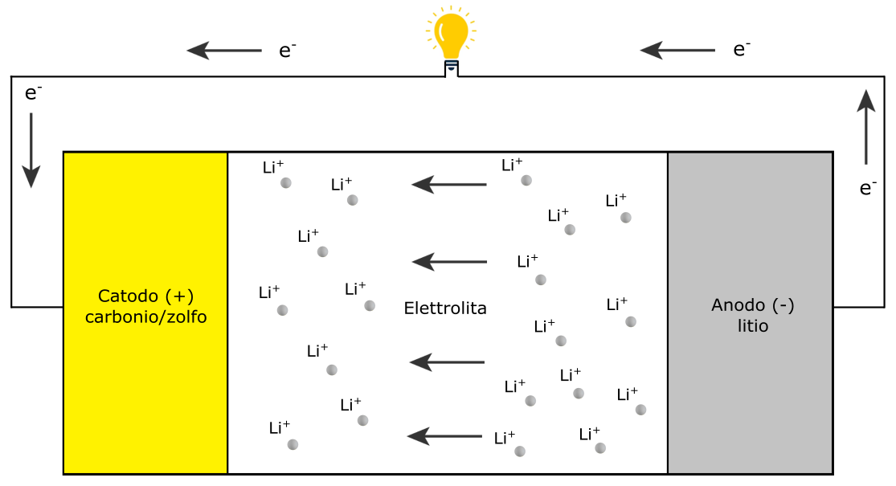
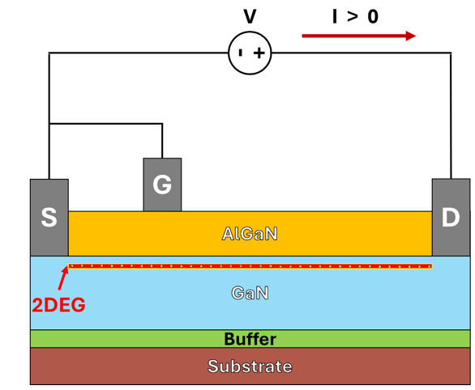

Introduction and Project Goal
PhD Title: Development of Nanostructured Materials and Correlative Microscopy Techniques for the Analysis and Optimization of Electrochemical and Semiconductor Devices
Thesis Title: Carbon-Sulfur Nanostructured Composites for Electrochemical Storage
Thesis Advisor: Prof. Leonardo Mattiello
External Thesis Advisor: Dr. Nicola Lisi (Enea Casaccia Research Center)
Specific Objective 1: Increase the specific capacity of cathodes for Li-S batteries using Carbon NanoWalls (CNW) nanostructures.
Specific Objective 2: Develop correlative microscopy workflows to identify and characterize defects in GaN HEMT devices. (Leonardo S.p.A.)
Li-S Battery during Discharge Phase
GaN HEMT device
PhD in Mathematical Models for Engineering, Electromagnetics and Nanosciences XL Cycle
Roberto Colarelli 1794473

Slide 3
Project Idea:
Correlative Microscopy for Multiscale Characterization of Semiconductor Materials and Devices
Combining Imaging Techniques: Utilizing different imaging methods allows researchers to capture diverse data from a single sample, with light microscopy providing general morphology and electron microscopy revealing fine structural details.
Enhanced Resolution and Information Depth: Correlating data from various microscopy techniques achieves higher resolution and deeper understanding, essential for studying complex structures.
Improved Contextual Understanding: Correlative microscopy examines samples in their native context, offering a holistic view of spatial relationships between structural components.
Comprehensive Chemical and Structural Analysis: Techniques like EDX combined with electron microscopy provide detailed chemical composition analysis, enhancing material property understanding.
Defect Analysis and Characterization: Identifying and characterizing defects at various scales with different microscopy techniques helps understand the origins and impacts of these defects on material performance.
PhD in Mathematical Models for Engineering, Electromagnetics and Nanosciences XL Cycle
Roberto Colarelli 1794473

Slide 4
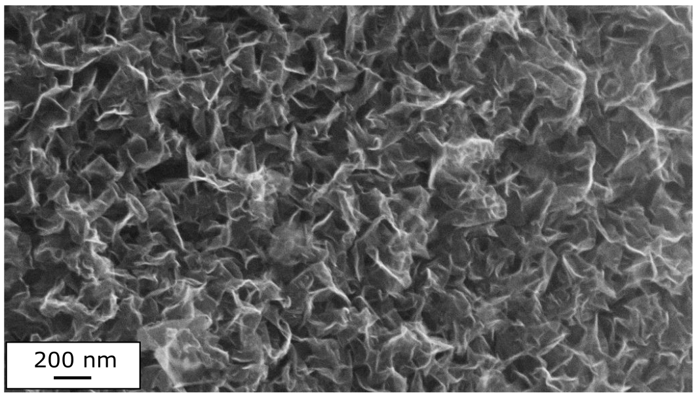
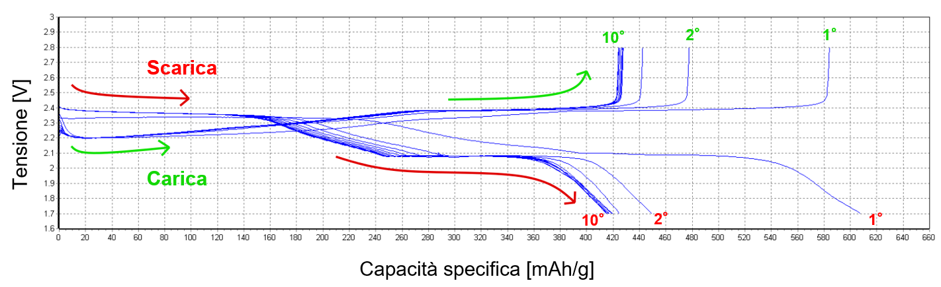
Methods and Results for Li-S Batteries
Materials Used:
Carbon Paper (CP) as Substrate
Growth of Carbon NanoWalls (CNW)
Solid-Phase Sulfur Deposition
Characterization Techniques:
Scanning Electron Microscopy (SEM) to Confirm the Presence of CNWs
Galvanostatic Cycling to Analyze the Electrochemical Behavior of the Nanostructured Cathode
Expected Results:
Increase in Specific Capacity (ideal value: 1675 mAh/g)
Improvement in Cycle Life and Stability
Enhanced Reversibility of the Charge Cycle Relative to the Discharge Cycle
Applications:
Electrical Energy Storage for Renewable Energy Storage (automotive, power grids, mobile electronic devices)
SEM Image of CNW Nanostructure at 80kx Magnification
Voltage Profile as a Function of Specific Capacity for the First 10 Cycles
PhD in Mathematical Models for Engineering, Electromagnetics and Nanosciences XL Cycle
Roberto Colarelli 1794473

Slide 5
Correlative Microscopy for the Characterization of Nanostructured Cathodes in Li-S Batteries
Goal: Enhance the specific capacity of Li-S battery cathodes using Carbon NanoWalls (CNW) nanostructures.
Detailed Morphological Analysis: Correlative microscopy enables precise visualization of CNW nanostructures, aiding in understanding their morphology and distribution, which is crucial for optimizing cathode structure to increase specific capacity.
Chemical Composition Mapping: Combining techniques like SEM and EDX allows for detailed mapping of sulfur and carbon distribution within cathodes, ensuring uniform and efficient interaction between sulfur and CNWs, essential for battery performance.
Performance Correlation: By correlating microscopic data with electrochemical performance, researchers can identify structural features of CNWs that enhance battery capacity and efficiency, aiding in the design of better-performing cathodes.
Identification of Structural Defects: Correlative microscopy can reveal defects in CNWs that may affect battery performance. Understanding these defects can lead to improved synthesis processes and material quality, ultimately enhancing the battery's specific capacity.
PhD in Mathematical Models for Engineering, Electromagnetics and Nanosciences XL Cycle
Roberto Colarelli 1794473

Slide 6

Methods and Results for GaN HEMT
Project Output:
Optimized Workflow for Failure Analysis and Defect Reports for Devices
Applications:
Use in Electric Vehicles, Power Electronics Devices, and Advanced Communication Technologies
Advantages of Correlative Microscopy:
Multiscale and Detailed Imaging of Samples in the Same Acquisition Area
Morphological, Structural, and Compositional Characterization
Precise Defect Identification
Specific Objectives:
Identification of Defects in GaN HEMT Devices
Correlation Between Microstructural Properties and Device Performance,
Enhancement of Semiconductor Reliability and Performance
150 V GaN HEMT device
PhD in Mathematical Models for Engineering, Electromagnetics and Nanosciences XL Cycle
Roberto Colarelli 1794473

Slide 7
Correlative Microscopy for the Characterization of GaN HEMT Devices
Goal: Develop workflows using correlative microscopy to identify and characterize defects in GaN HEMT (High Electron Mobility Transistor) devices.
Comprehensive Defect Characterization: Correlative microscopy provides detailed images of surface and subsurface defects. Techniques like AFM combined with SEM can identify and characterize defects impacting GaN HEMT device performance.
High-Resolution Defect Imaging: High-resolution techniques like TEM offer atomic-level images of defects within GaN crystals, crucial for understanding their nature and impact on device reliability and performance.
In-Situ Defect Analysis: Correlative microscopy allows for real-time monitoring of defects during device operation, aiding in understanding defect evolution under operational conditions, essential for improving device design and durability.
Cross-Sectional Defect Analysis: Using FIB combined with electron microscopy prepares cross-sectional samples of GaN HEMT devices, revealing hidden defects and their impact on different layers and interfaces.
PhD in Mathematical Models for Engineering, Electromagnetics and Nanosciences XL Cycle
Roberto Colarelli 1794473

